Slide 1
Tableau

Slide 2
Tableau
It is a BI tool for visually analyzing the data.
Users can create and distribute an interactive and shareable dashboard.
It depicts the trends , variations and density of data in the form of graphs and charts.
It can connect to files , relational and Big Data sources to acquire and process data.
The software allows data blending and real time collaboration , which makes it very unique.
It is used by businesses , academic researchers and many government organizations for visual data analysis.

Slide 3
Pre - Requisites
Computer Programming Terminologies.
Data Analysis.
Types of graphs and charts.
SQL.

Slide 4
Tableau - Overview
Tableau has many important features.
Powerful data discovery and exploration application allows you to answer important questions in seconds.
Tableau’s drag and drop interface can be used to visualize any data , explore different views and even combine multiple databases.
It does not require any complex scripting.
Anyone who understands the business problems can address it with a visualization of the relevant data.

Slide 5
Tableau - Features
Speed Of Analysis: It does not require high level of programming expertise ,
any user with access to data can start using it to derive value from the data.
Self – Reliant: It does not require complex software setup .
The desktop version all the features.
Visual Discovery: The user explores and analyzes data by using visual tools like colors , trend lines , charts and graphs.

Slide 6
Tableau - Features
Blend Diverse Data Sets: It allows you to blend different relational , semistructured and raw data sources in real time , without up-front integration costs.
Architecture Agnostic: Tableau works in all kinds of devices where data flows.
User need not worry about different hardware or software requirements to use Tableau.
Real Time Colloboration: It can filter , sort and filter data on the fly and embed a live dashboard in portals like Sharepointsite or salesforce.

Slide 7
Tableau - Features
Centralized data: It provides a centralized location to manage all of the organization’s published data sources.
We can delete , change permissions , add tags and manage schedules in one convenient location.
It’s easy to schedule exact refreshes and manage schedules in one convenient location.

Slide 8
Tableau – Environment Setup
Download Tableau Desktop:
The personal edition of Tableau desktop can be downloaded.
We need to register with the details to be able to be downloaded.
After downloading , the installation process is very straightforward.
Accept the licence agreement and provide the target folder for installation.

Slide 9
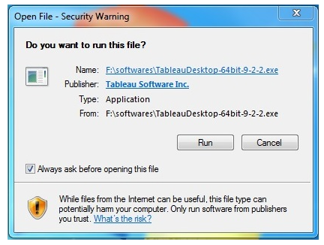
Tableau – Environment Setup
Start the Installation Wizard:
Double – click the TableauDesktop-64bit-9-2-2.exe.
It will present a screen to allow the installation program to run.
Click “run”.

Slide 10
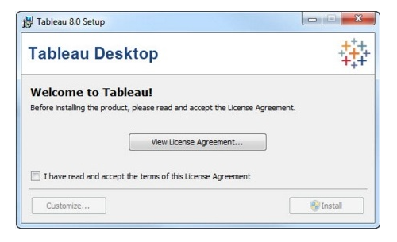
Tableau – Environment Setup
Accept the Licence Agreement:
Read the licence agreement and if you agree, choose the “I have read and accepted the terms of this licence agreement” option.
Then , click “Install”.

Slide 11
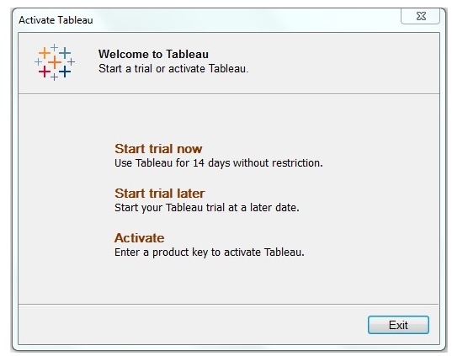
Tableau – Environment Setup
Start Trial:
When the installation is completed , the screen prompts us with the option to start the trial now or later.

Slide 12
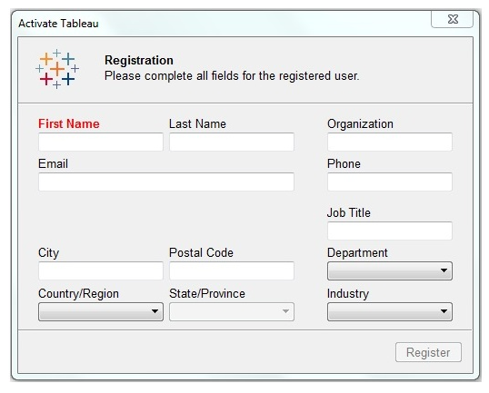
Tableau – Environment Setup
Provide Your Details:
Provide your name and organization details.
Then , click next.

Slide 13
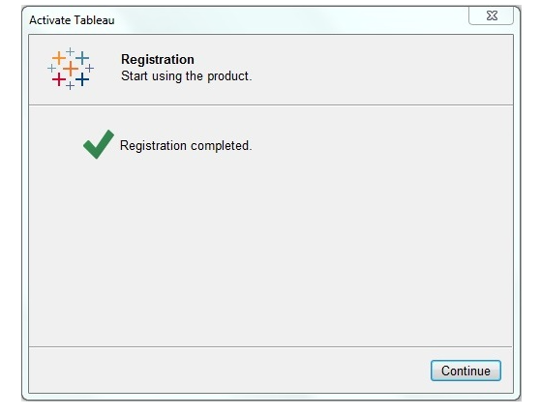
Tableau – Environment Setup
Registration Complete:
The registration completion screen appears. Click “Continue”.

Slide 14
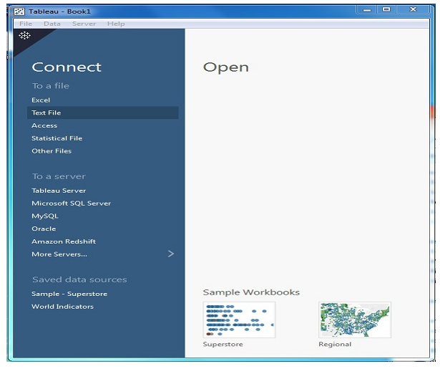
Tableau – Environment Setup
Verify the Installation:
We can verify the installation by going to the windows start menu.

Slide 15
Tableau – Get Started
There are three basic steps involved in creating any Tableau Data Analysis report.
The following are the steps:
Connect To a Data Source:
It involves locating the data and using an appropriate type of connection to read the data.
Choose dimensions and measures:
This involves selecting the required columns from the source data for analysis.

Slide 16
Tableau – Get Started
Apply Visualization Technique: This involves applying required visualization methods such as specific chart to the data being analyzed.
Use the sample data that comes with the Tableau installation named sample – superstore.xls.
Locate the installation folder of Tableau and go to My Tableau Repository.
Under it, you will find the above file at Datasources\9.2\en_US-US.

Slide 17
Tableau – Get Started
Connect to a Data Source:
When we open tableau , we will get the start page showing various data sources.
Under the header “Connect” , we have options to choose a file or server or saved data source.
Under files , choose excel.
Then navigate to the file “Sample – Superstore.xls”.
The excel file has three sheets named Orders , Returns and People.
Choose Orders.

Slide 18
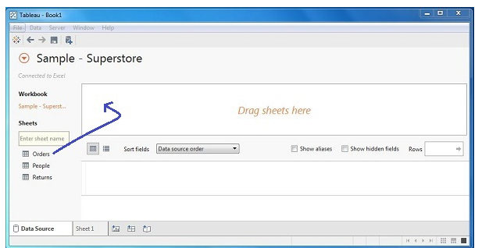
Tableau – Get Started

Slide 19
Tableau – Get Started
Choose the dimensions and measures:
Choose the data to be analyzed by deciding on the dimensions and measures.
Dimensions are the descriptive data while measures are the numeric data.
Choose Category and Region as the dimensions and Sales as the measure.
The result shows the total sales in each category for each region.

Slide 20
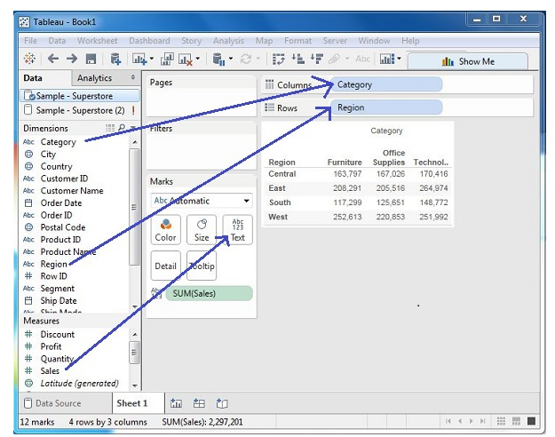
Tableau – Get Started

Slide 21
Tableau – Get Started
Apply Visualization Technique:
In the previous step , all the data is available only as numbers.
We need to read and calculate each of the values to judge the performance.
We can see them as graphs or charts of different colours to make a quicker judgement.
Drag and drop the sum(sales) column from the Marks tab to the Columns shelf.

Slide 22
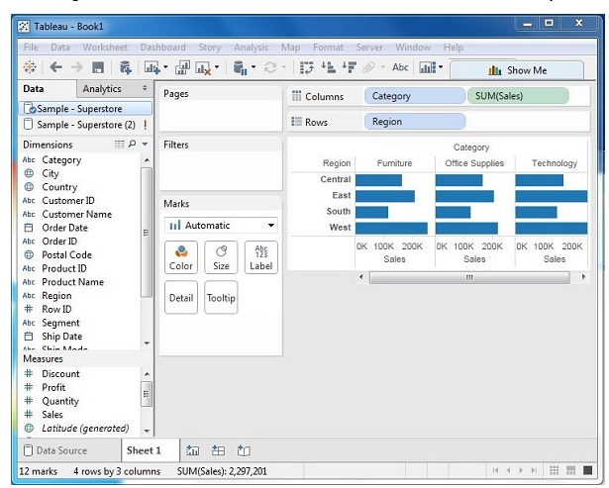
Tableau – Get Started

Slide 23
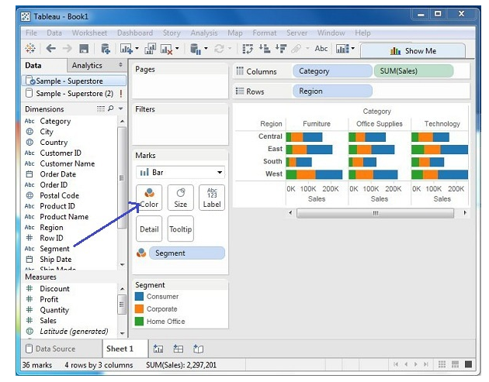
Tableau – Get Started
We can apply a technique of adding another dimension to the existing data.

Slide 24
Tableau - Navigation
When we run Tableau desktop , we get the menu at the top which shows all the commands we can navigate.

Slide 25
Tableau - Navigation
Menu Commands:
When we close the getting started window , we get the main interface with all the available Menu commands.
They denote the entire set of features available in Tableau.
Various sections of the menu are shown in the following diagram.

Slide 26
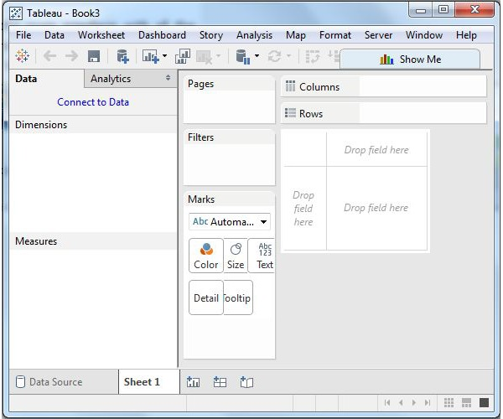
Tableau - Navigation

Slide 27
Tableau - Navigation
File Menu:
This menu is used to create a new Tableau workbook and open existing workbooks from both the local file system and Tableau server.
Following are the important features of the menu:
Workbook Locale:
It sets the language to be used in the report.
Paste Sheets:
Pastes a sheet into the current workbook , which is copied from another workbook.

Slide 28
Tableau - Navigation
Export packaged workbook:
This option is used to create a packaged workbook , which will be shared with other users.
Menu Commands:
When we close the getting started window , we will get the main interface with all available menu commnands.

Slide 29
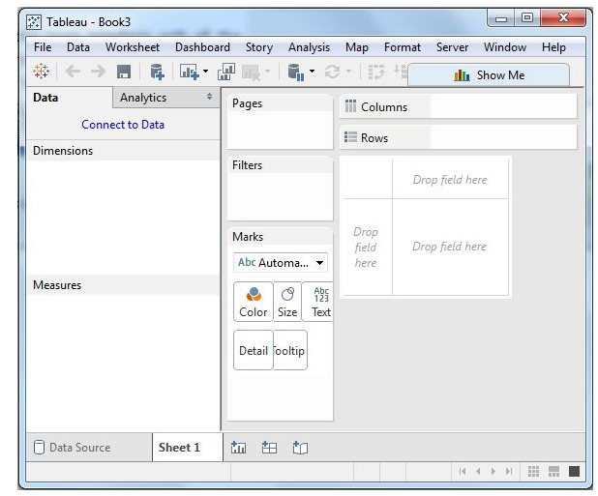
Tableau - Navigation
Menu Commands:
They represent the entire set of features available in Tableau.
Various sections of the menu are shown in the following diagram:

Slide 30
Tableau - Navigation
File Menu:
This menu is used to create a new Tableau workbook and open existing workbooks from both the local system and the Tableau server.
Workbook Locale: It sets the language to be used in the report.
Paste Sheets: Pastes a sheet into the current workbook which is copied from another workbook.
Export Packaged Workbook: It is used to create a packaged workbook , which will be shared with other users.

Slide 31
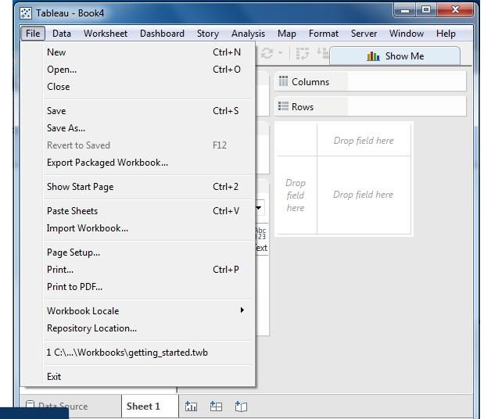
Tableau - Navigation

Slide 32
Tableau - Navigation
Data Menu:
This menu is used to create a new data source to fetch the data for analysis and visualization.
It allows us to replace the existing data source.
New Data Source: Allows us to view all types of connections available and choose from it.
Refresh All Extracts: Refreshes the data from the source.
Edit Relationships: Defines the fields in more than one data source for linking.

Slide 33
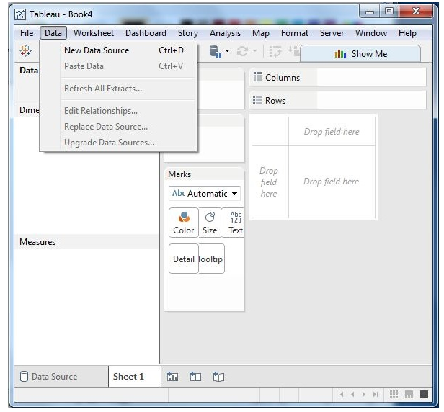
Tableau - Navigation

Slide 34
Tableau - Navigation
Worksheet Menu:
This menu is used to create a new worksheet along with various display features like showing the title and captions.
Show Summary: It allows us to view the summary of data used in the worksheet like count,etc.
Tooltip shows the tooltip when hovering above various data fields.
Run Update: Updates the worksheet data or filters used.

Slide 35
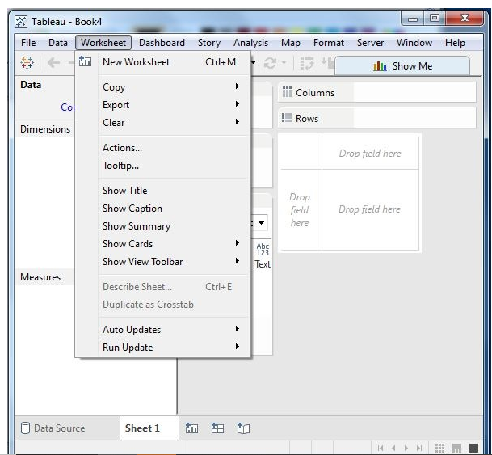
Tableau - Navigation

Slide 36
Dashboard Menu
This menu is used to create a new dashboard along with various display features like showing the title and displaying the image.
Format : sets the layout in terms of colours and sections of the dashboard.
Actions: Link the dashboard sheets to external URLs or other sheets.
Export Image: It exports an image of the dashboard.

Slide 37
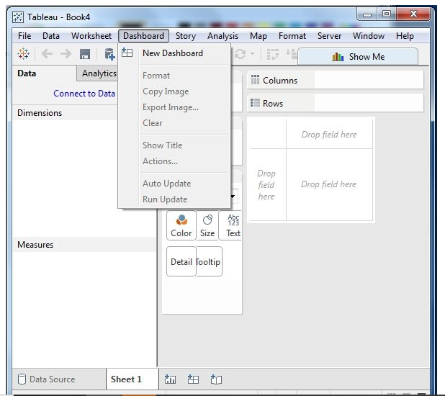
Dashboard Menu

Slide 38
Tableau - Navigation
Story Menu:
This menu is used to create a new story with many sheets with related data.
Format: Sets the layout in terms of colours and sections of the story.
Run Update: Updates the story with the latest data from the source.
Export Image: Exports an image of the story.

Slide 39
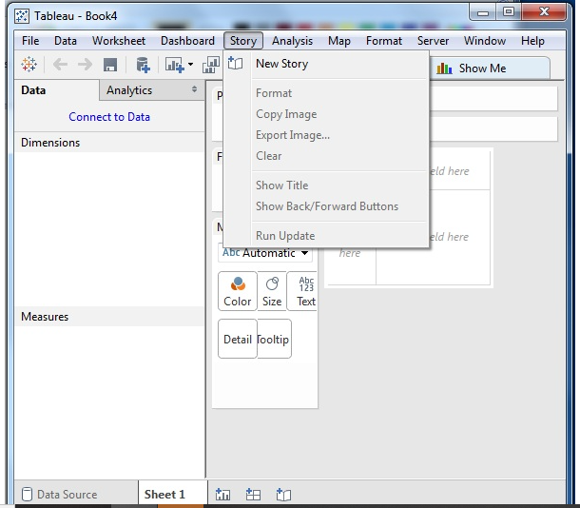
Tableau - Navigation

Slide 40
Tableau - Navigation
Analysis Menu:
It is used for analyzing the data present in the sheet.
Forecast: Shows a forecast based on the available data.
Trend Lines: Shows the trend line for a series of data.
Create Calculated Field: Creates additional fields based on certain calculation on the existing fields.

Slide 41
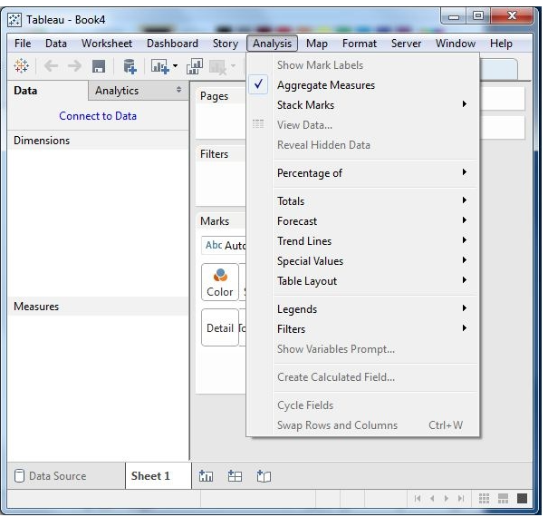
Tableau - Navigation
Analysis Menu:

Slide 42
Tableau - Navigation
Map Menu:
This menu is used for building map views in Tableau.
Geographic roles can be assigned to fields in the data.
Map Layers: Hides and shows map layers , like street names , counrty borders and adds data layers.
Geocoding: Creates new geographic roles and assigns them to geographic fields in the data.

Slide 43
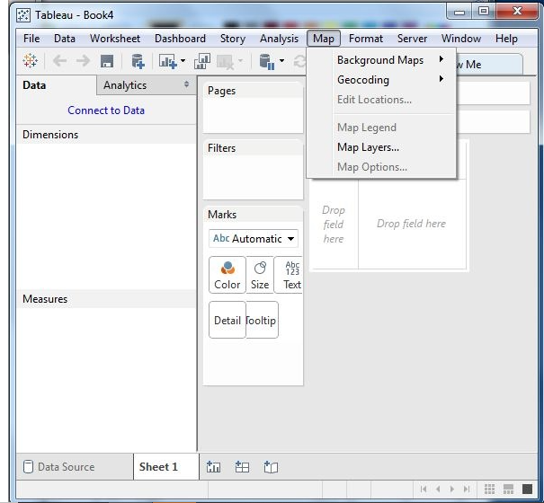
Tableau - Navigation

Slide 44
Tableau - Navigation
Format Menu:
This menu is used for creating various formatting options to enhance the look and feel of the dashboards created.
Borders: Applies borders to the fields applied in the report.
Title and Caption: Assigns a title and caption to the reports.
Cell Size: Customizes the size of the cells displaying the data.
Workbook Theme: Applies a theme to the entire workbook.

Slide 45
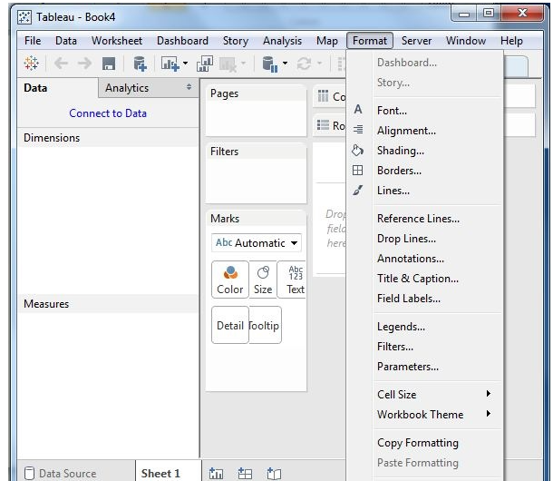
Tableau - Navigation

Slide 46
Tableau - Navigation
Server menu:
This menu is used to login to the Tableau server if you have access , and publish the results to be used by others.
It is used to access the workbook published by others.
Publish Workbook: publishes the workbook in the server to be used by others.
Publish Data Source: publishes the source data used in the workbook.
Create User Filters: Creates filters on the worksheet to be applied by various users while accessing the report.

Slide 47
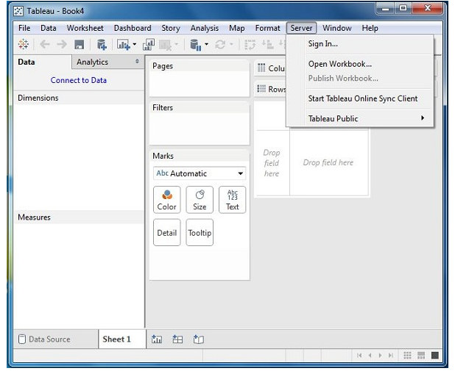
Tableau - Navigation

Slide 48
Tableau – Design Flow
Tableau helps in analyzing lots of data over diverse time periods , dimensions and measures .
It is important to know the method in order to design a good dashboard.
Best practices should be followed in order to create good worksheets and dashboards.

Slide 49
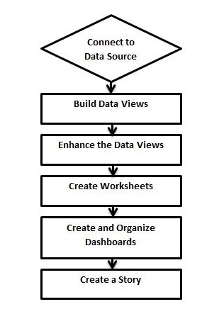
Tableau – Design Flow

Slide 50
Tableau – Design Flow
Connect To a Data Source:
Tableau connects to all popular data sources.
It has in – built connectors which takes care of establishing the connection.
Tableau connects to all data sources like text files , relational sources , SQL sources or cloud data bases.

Slide 51
Tableau – Design Flow
Build Data Views:
After connecting to a data source , we get all the column and data available in the Tableau environment.
We classify them as dimensions and measures and create any hierarchy required.
Using these , we build views , which are called as reports.
Tableau provides easy drag and drop feature to build views.

Slide 52
Tableau – Design Flow
Enhance the views:
The views created above needs to be enhanced further by the use of filters , aggregations , labeling of axes , formatting of colours and borders, etc.
Create Worksheets:
Create different worksheets to create different views on the same or different data.

Slide 53
Tableau – Design Flow
Create and Organize Dashboards:
Dashboards contain multiple worksheets which are linked.
The action in any of the worksheet can change the result in the dashboard accordingly.
Create a Story:
A story is a sheet that contains a sequence of worksheets that work together to convey information.
We can create stories to show how facts are connected, provide context ,
Demonstrate how decisions relate to outcomes .

Slide 54
Tableau – File Types
The result of data analysis in Tableau can be saved in different formats.
The various formats are identified as different file types and they are identified by different file extensions.
They are all stored as xml files and they can be opened and edited.

Slide 55
Tableau – File Types
File Type | File Extension | Purpose
Tableau Workbook | .twb | It contains information on each sheet and dashboard that is present in the worksheet.
Tableau Packaged workbook | .twbx | This file format contains the details of the workbook.
Tableau Data Source | .tds | The details of the connection used to create a Tableau report are stored in this file.
Tableau Packaged Data Source | .tdsx | This file is similar to the .tds file with the addition of data.

Slide 56
Tableau – File Types
File Type | File Extension | Purpose
Tableau Data Extract | .tde | This file contains the data used in a .twb file in a highly compressed columnar data format.
Tableau Bookmark | .tbm | These files contain a single worksheet that is easily shared to be pasted into other workbooks.
Tableau Preferences | .tps | This file stores the colour preference used across all the workbooks.

Slide 57
Tableau – Data Types
Tableau classifies every piece of data into one of four categories namely,
String, Number , Boolean and datetime.
Once the data is loaded from the source , Tableau automatically assigns the data types.
We can also change some of the data types if it satisfies the data conversion rule.

Slide 58
Tableau – Data Types
STRING: Any sequence of zero or more characters.
Eg: ‘Hello’
NUMBER: They are either integers or floating points.
Eg:3
The floating point numbers should be rounded while using them calculations.
BOOLEAN: They are logical values.Eg: True,False.

Slide 59
Tableau – Data Types
DATE AND TIME: Tableau recognises the dates in almost all the formats.
If we want Tableau to recognize string as a date, then a hash sign is included before the data.Eg: "02/01/2015"
"#3 March 1982"

Slide 60
Tableau – Data Sources
Tableau can connect to all possible data sources.
File Systems : like csv , excel, etc.
Relational Systems: like Oracle , sql server , DB2 , etc.
Cloud Systems: like Windows azure , Google Big Query.
Other Sources: using ODBC.

Slide 61
Tableau – Data Sources
Connect Live:
This feature is used for real – time data analysis.
Tableau connects to real – time data source and keeps reading the data.
Thus , the result of analysis is up to the second and the latest changes are reflected in the result.
It burdens the source system as it has to keep sourcing the data to Tableau.

Slide 62
Tableau – Data Sources
In – Memory :
It can also process data in memory by caching them in memory .
It is not being connected to the source anymore while analyzing the data.
There will be a limit to the amount of data being cached depending on the availability of memory.

Slide 63
Tableau – Data Sources
Combine Data Sources:
Tableau can connect to different data sources at the same time.
For eg , in a single workbook , we can connect to a flat file and a relational source by defining multiple connections.
This is used in data blending , which is a unique feature in Tableau.

Slide 64
Tableau – Custom Data View
A custom data view is used to extend the normal view with some additional features.
The view can give different types of charts for the same underlying data.
We can drill down a dimension field which is a part of a pre – defined hierarchy so that additional values of a measure are obtained at a higher granularity.

Slide 65
Tableau – Custom Data View
Drill Down View:
For dimensions fields which are part of a hierarchy , we need to know the result of analysis for the next level of aggregation.
If we know the result for a quarter , we get interested to know the results for each month in that quarter.
We may even need the result for each week.
This is an example of drilling down the dimensions to get a finer level of granularity.

Slide 66
Tableau – Custom Data View
Drill Down View:
To drill down and drill up for individual members in a hierarchy , right – click a table header and select drill down from the context menu.
Consider a bar chart created with the dimension category in the columns shelf and measure Sales in the row shelf.
Right – click on the bar denoting furniture and select Drill Down.

Slide 67
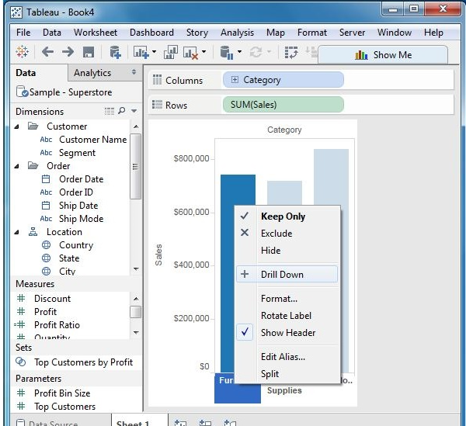
Tableau – Custom Data View

Slide 68
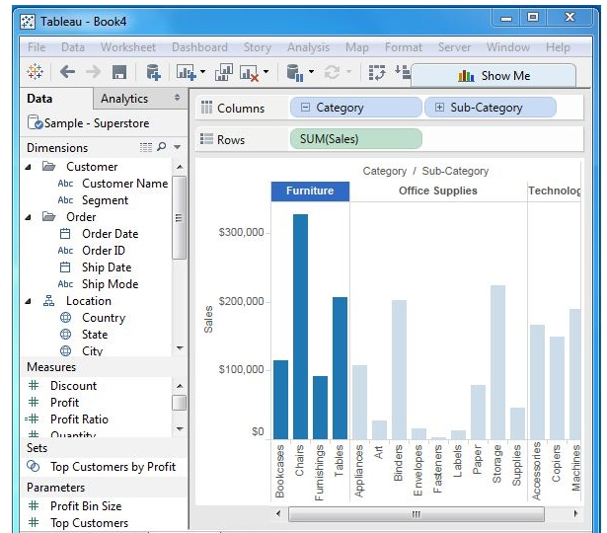
Tableau – Custom Data View
Follwing is the result of drill down action.

Slide 69
Tableau – Custom Data View
Swapping Dimensions:
We can create a new view from an existing view by swapping the position of the dimensions.
This does not change the values of the measures , it does change the position of the measures.
Consider a view for analyzing the profit for each year for each segment and category of products.
We can click on the category line at the end of category column and drag it to the segment column.

Slide 70
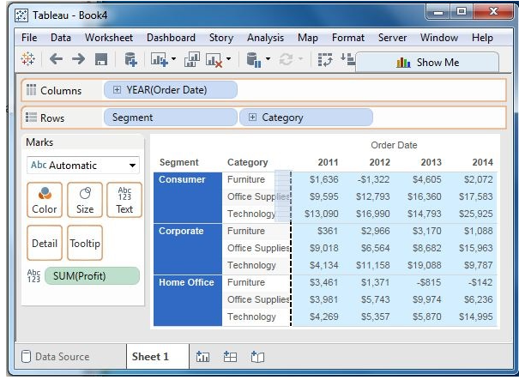
Tableau – Custom Data View

Slide 71
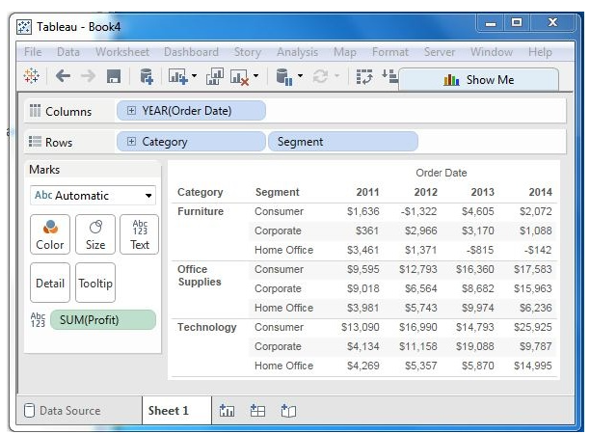
Tableau – Custom Data View
As you can see, only the position of the values of the measure Profit changes for each category and segment, and not its value.

Slide 72
Tableau – Custom Data View
Swapping Dimensions:
A new view can be created from an existing view by swapping the position of the dimensions.
This does not change the values of the measures but it does change the position of the measures.
Consider a view for analyzing the profit for each year for each segment and category of products.
Click the vertical line at the end of category column and drag it to the segment column.

Slide 73
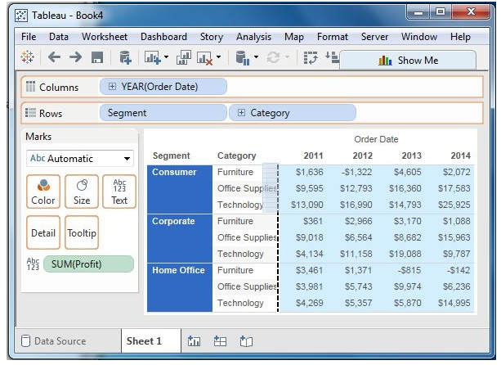
Tableau – Custom Data View
Swapping Dimensions:

Slide 74
Tableau – Custom Data View
Swapping Dimensions:
Following is the result of swapping two dimensions:
We can see that only the position of values of the measure Profit changes for each category and segment , and not its value.

Slide 75
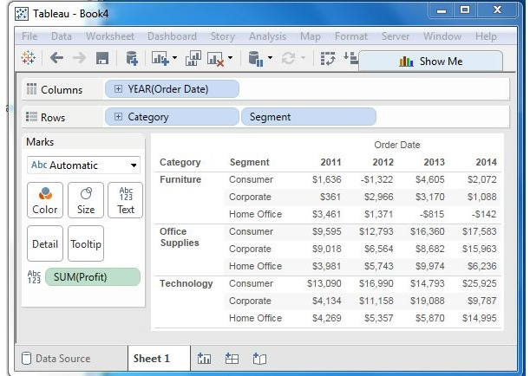
Tableau – Custom Data View

Slide 76
Tableau – Extracting Data
Data extraction in Tableau creates a subset of data from the data source.
This is useful in increasing the performance by applying filters.
It also helps in applying some features of Tableau like finding the distinct values in the data.

Slide 77
Tableau – Extracting Data
Creating an Extract:
Extraction is done by the following: Data -> Extract Data.
It creates many options such as applying limits to how many rows to be extracted .

Slide 78
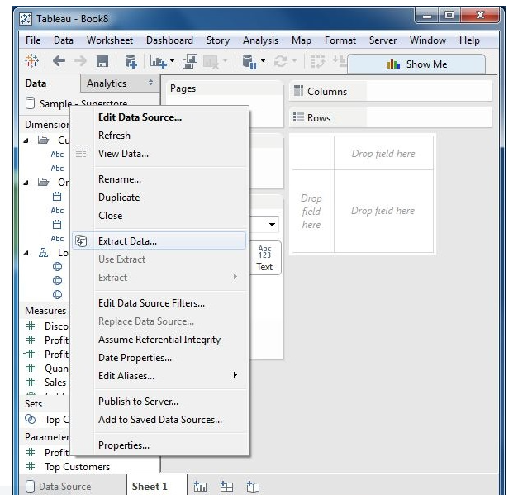
Tableau – Extracting Data

Slide 79
Tableau – Extracting Data
Applying Extract Filters:
To extract a subset of data from the data source , we can create filters which will return only the relevant rows.
Consider the sample superstore dataset and create an extract.
In the filter option , choose select from list and tick mark the check box value for which you need to pull the data from the source.

Slide 80
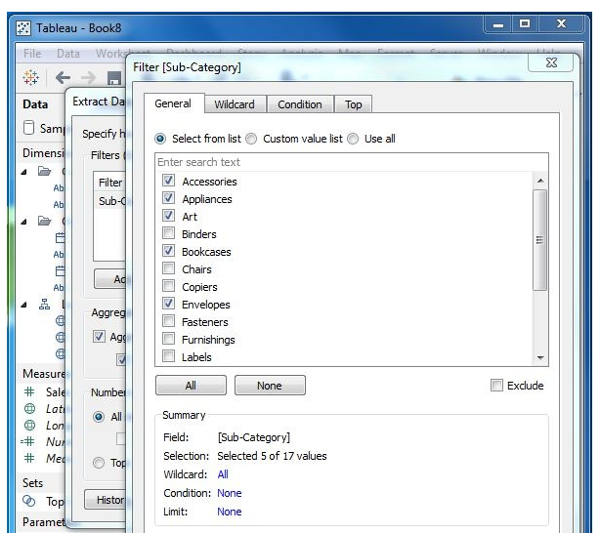
Tableau – Extracting Data
Applying Extract Filters:

Slide 81
Tableau – Extracting Data
Adding new data to the extract:
To add more data for an already created extract , choose the option Data-> Extract-> Append data from file.
Browse the file containing the data and click ok to finish.
The number and datatype of the columns in the file should be in sync with the existing data.

Slide 82
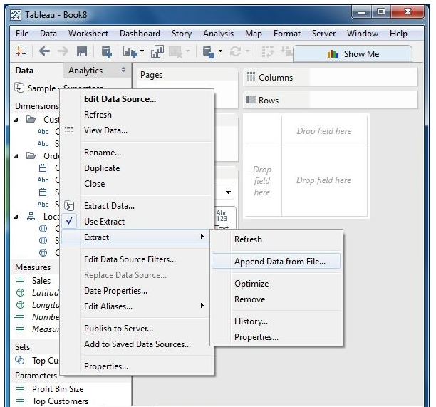
Tableau – Extracting Data

Slide 83
Tableau – Extracting Data
Extract History:
We can verify the history of data extracts to be sure about how many times the extract has happened and at what times.
We can use the menu - Data -> Extract History.

Slide 84
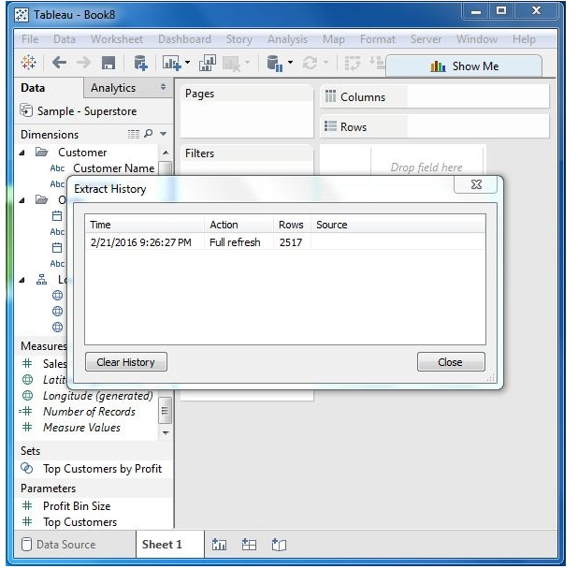
Tableau – Extracting Data

Slide 85
Tableau – Fields Operations
It has many features to manipulate the fields present in Tableau data pane.
We can rename the fields or combine two fields to create one field.
Such operations help in the organization of the dimensions and measures , as well as accommodate two or more fields with the same name for better data analysis.

Slide 86
Tableau – Fields Operations
Adding fields to worksheet:
We can add any field to the worksheet by right – clicking and choosing the option Add to Sheet.
We can also drag and drop the fields into different shelves present in the worksheet , like columns shelf, Rows shelf, Filters shelf and many other shelfs under the master card.

Slide 87
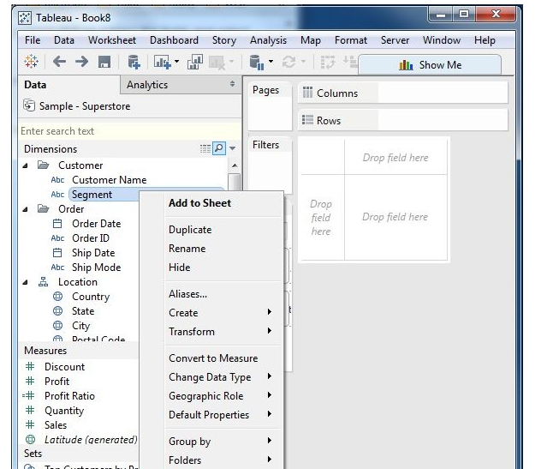
Tableau – Fields Operations

Slide 88
Tableau – Fields Operations
Combining Two Fields:
You can combine two dimension fields to create one field.
This combined field has a name which is a combination of the individual fields.
The values in the dimension get combined to a single value by joining the two strings into one string separated by comma.
The default field can be changed using the rename field operation.

Slide 89
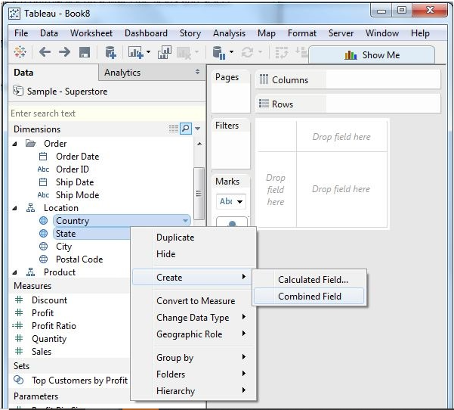
Tableau – Fields Operations
Combining Two Fields:
We can create two dimension field to create one field.

Slide 90
Tableau – Fields Operations
Searching Fields:
We can search for names of fields using the search box option.
When we write the first three or more letters of the name field, it brings out the result showing only the fields whose name contains the letters.

Slide 91
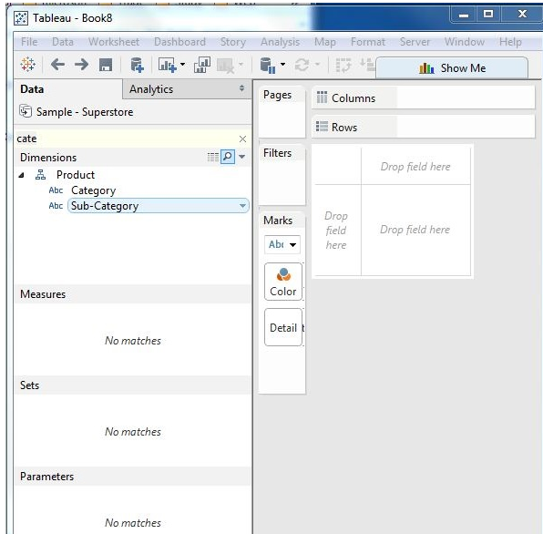
Tableau – Fields Operations

Slide 92
Tableau – Fields Operations
Reordering Fields:
We can change the position of fields by simply dragging them up and down.
In the following example , we drag the field customer name to the place between state and city.
They are done to bring similar fields together whiach are frequently used for analysis.

Slide 93
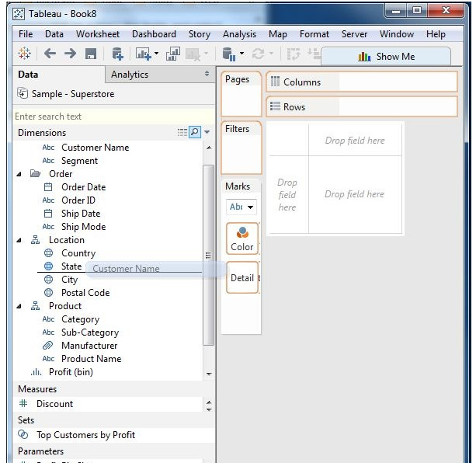
Tableau – Fields Operations
Reordering Fields:

Slide 94
Tableau – Editing Metadata
After connecting to the data source , it captures the metadata details of the source like columns and their data types.
It is used to create the dimensions , measures and calculated fields used in the views.
We can browse the metadata and change some of its properties for some specific requirements.

Slide 95
Tableau – Editing Metadata
After connecting to the data source , Tableau captures the metadata details of the source like the columns and their data types.
It is used to create the dimensions , measures and calculated fields used in the views.
We can browse the metadata and change some of the properties for some specific requirements.

Slide 96
Tableau – Editing Metadata
Checking the Metadata:
After connecting to a data source , Tableau presents all possible tables and columns present in the source.
Consider the source ‘Sample Coffee shop’ for checking the metadata.
Click the data menu and choose to connect to a data source.
Browse for the MS access file named ‘Sample – Coffee shop’.
Drag the table named Product to the data canvas.
On choosing the file , we get the following screen which shows the column names and their data types.

Slide 97
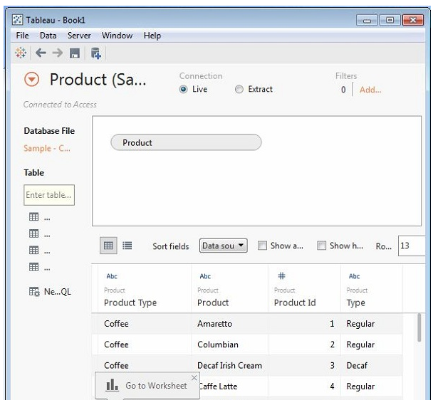
Tableau – Editing Metadata
Checking the Metadata:
The string data types are shown as Abc and the numeric data types are shown as #.

Slide 98
Tableau – Editing Metadata
Changing the Data Type:
The datatype of some of the fields can be changed if required.
Depending on the nature of source data , Tableau cannot recognize the data type from the source.
In those cases , the data type can be edited manually.

Slide 99
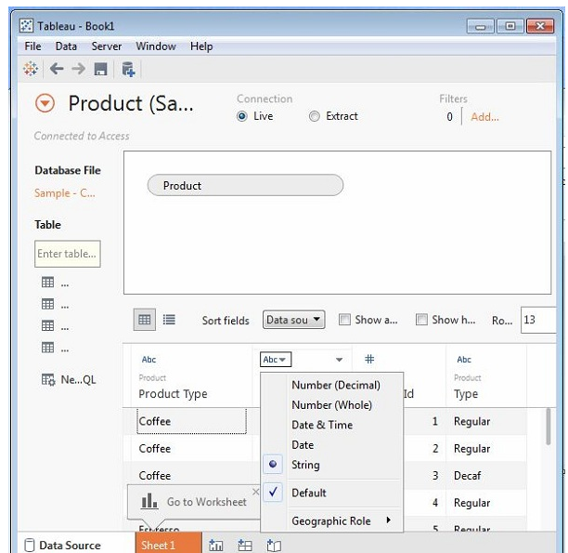
Tableau – Editing Metadata

Slide 100
Tableau – Editing Metadata
Renaming and Hiding:
The column names can be changed using the renaming option.
We can also hide a column so that it does not appear in the data view that we create.
These options are available by clicking on the data type icon in the metadata grid .

Slide 101
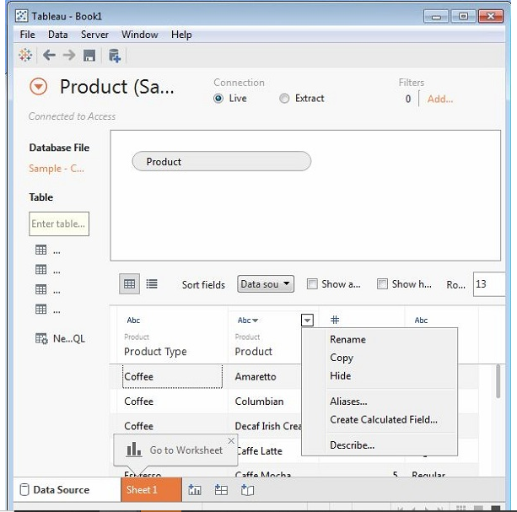
Tableau – Editing Metadata

Slide 102
Tableau – Editing Metadata
Column Alias:
Each column of the data source can be assigned an alias which helps better understand the nature of the column.
We can choose the aliases option from the above step .
The following screen is used to create and edit aliases.

Slide 103
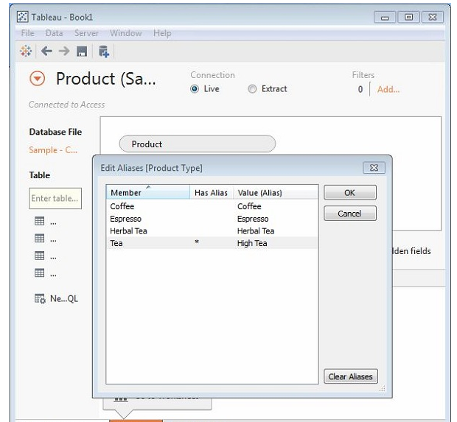
Tableau – Editing Metadata

Slide 104
Tableau – Data Joining
It is a very common requirement in any data analysis.
We may need to join data from multiple sources or join data from different tables in a single source.
It provides feature to join the table by using the data pane available under the Edit Data Source in the Data Menu.

Slide 105
Tableau – Data Joining
Creating a Join:
Consider the data source ‘Sample Superstore’ to create a join between Orders and Returns table.
Go to the data menu and choose the option Edit Data Source.
Drag the two tables Orders and Returns to the data pane.
Depending on the field name and data type , Tableau will automatically create a table which can be changed later.

Slide 106
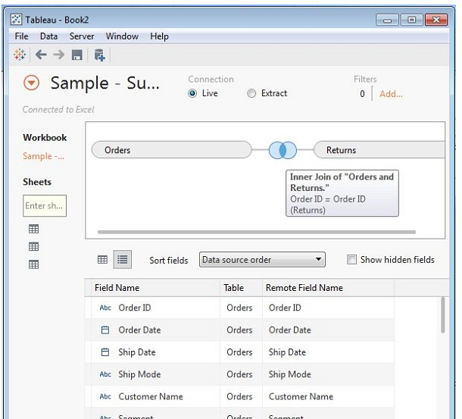
Tableau – Data Joining
Creating a Join:

Slide 107
Tableau – Data Joining
Editing a Join Type:
The type of join which the table creates automatically can be changed manually.
Click the middle of the two circles showing the join.
A popup window appears which shows the four types of joins available.
Tableau automatically greys out some types of joins , which it finds irrelevant on the basis of data present in the data source.

Slide 108
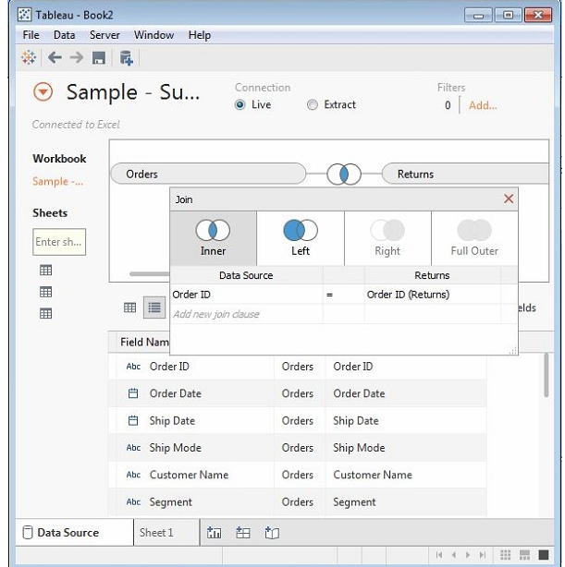
Tableau – Data Joining
Editing a Join Type:

Slide 109
Tableau – Data Joining
Editing Join Fields:
We can also change the fields forming the join condition by clicking the data source option available in the join popup window.
While selecting the field , we can also search for the field we are looking for using the search text box.

Slide 110
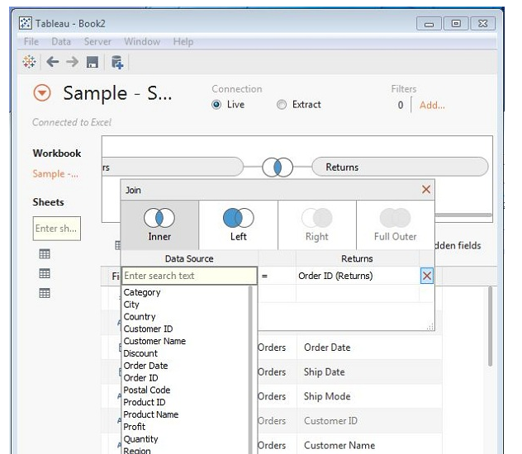
Tableau – Data Joining

Slide 111
Tableau – Data Blending
Data Blending is a very powerful feature in Tableau.
It is used when there is related data in multiple data sources , which we want to analyze together in a single view.
Consider the Sales data in a relational database and Sales target data in spreadsheet.
Compare the actual sales and the target sales , we can blend the data based on common dimensions to get access to the sales target measure.
The two sources involved in data blending are primary and secondary data sources.
A left join is created between the primary data source and the secondary data source with all the data rows from the primary data source and matching data rows from the secondary data source.

Slide 112
Tableau – Data Blending
Preparing Data For Blending:
Tableau has two in – built data sources named Sample – superstore and Sample coffee chain.mdb.
First , load the sample coffee chain to Tableau and look at its metadata.
Go to the menu – Data -> New Data Source and browse for the sample coffee chain file , which is MS access database file.

Slide 113
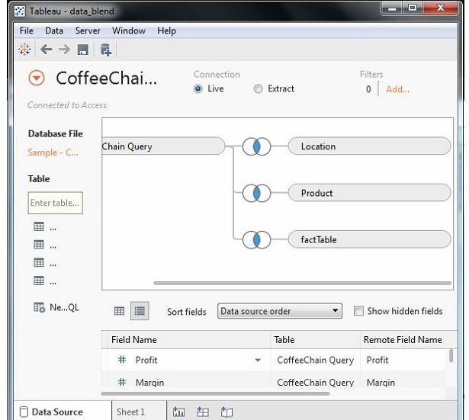
Tableau – Data Blending

Slide 114
Tableau – Data Blending
Adding Secondary Data Source:
Next , add the secondary data source named Sample – superstore by again following the steps – Data -> New Data Source and choosing this data source.
Both the data sources now appear on the Data window.

Slide 115
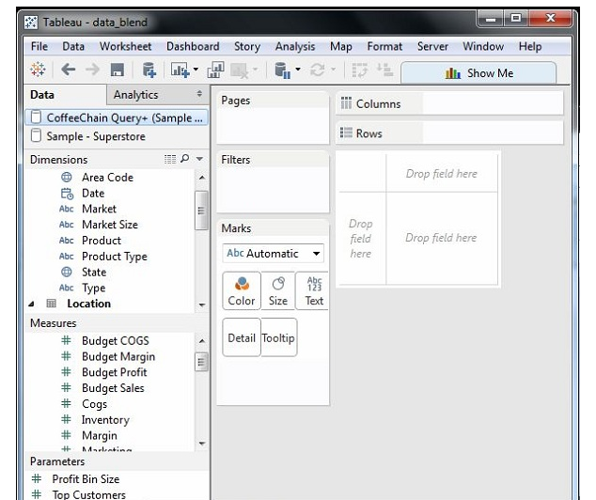
Tableau – Data Blending

Slide 116
Tableau – Data Blending
Blending the Data:
We can integrate data from the above sources based on a common dimension.
A small chain image appears next to the dimension called state.
It indicates the common dimension between the two data sources.
Drag the state field from the primary data source to the rows shelf and the field profit ratio from the secondary data source to the column shelf.
Select the bullet chart option from show me to get the bullet chart .
The chart shows how the profit ratio varies for each state in both the superstore and the coffee chain shops.

Slide 117
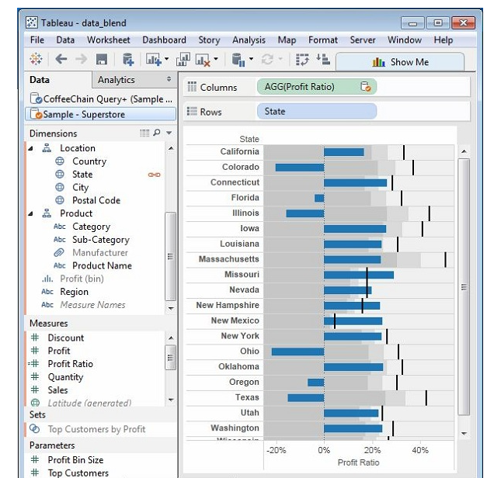
Tableau – Data Blending

